Slide 1
Logistic Regression
Geometric Intuition

Slide 2


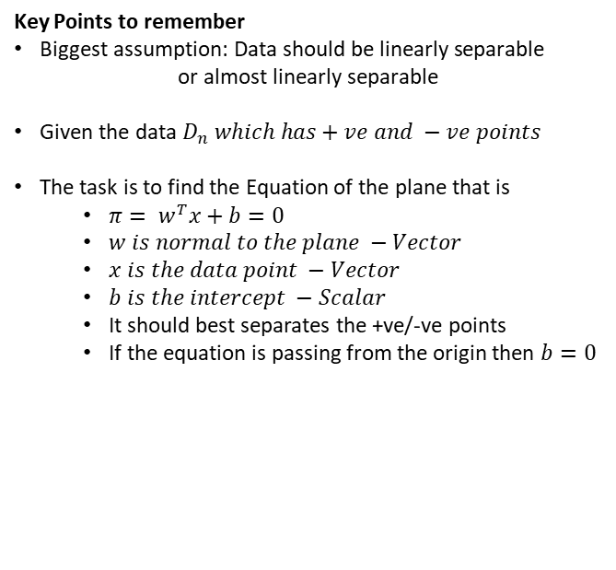


Geometric Intuition
Key Points to remember
$\text{Biggest} \text{assumption}\text{: }\text{Data} \text{should} \text{be} \text{linearly} \text{separable}$
$$\text{or} \text{almost} \text{linearly} \text{separable}$$
$\text{Given} \text{the} \text{data} D_{n} which has+ve and −ve points$
The task is to find the Equation of the plane that is
$π= w^{T}x+b=0$
$w is normal to the plane −Vector$
$x is the data point −Vector$
$b is the intercept −Scalar$
It should best separates the +ve/-ve points
If the equation is passing from the origin then $b=0$
$$Vector w$$
$$π$$

Slide 3


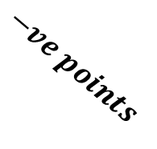
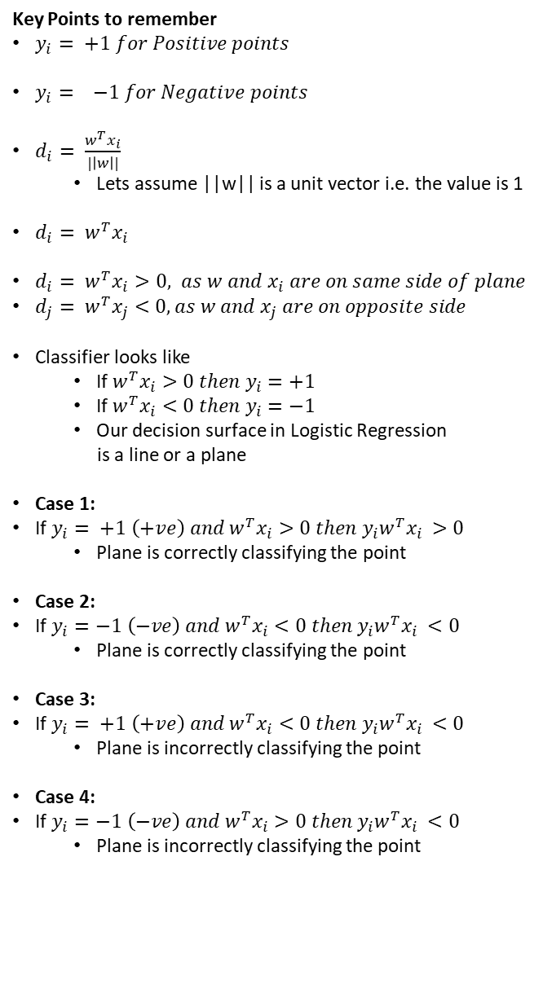
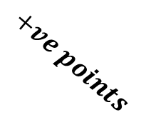




Geometric Intuition
Key Points to remember
$y_{i}= +1 for Positive points$
$y_{i}= −1 for Negative points$
$d_{i}= \frac{w^{T}x_{i}}{|\left|w\right||}$
Lets assume ||w|| is a unit vector i.e. the value is 1
$d_{i}= w^{T}x_{i}$
$d_{i}= w^{T}x_{i}>0, as w and x_{i} are on same side of plane$
$d_{j}= w^{T}x_{j}<0, as w and x_{j} are on opposite side$
Classifier looks like
If $w^{T}x_{i}>0 then y_{i}=+1$
If $w^{T}x_{i}<0 then y_{i}=−1$
Our decision surface in Logistic Regression
is a line or a plane
Case 1:
If $y_{i}= +1 \left(+ve\right) and w^{T}x_{i}>0 then y_{i}w^{T}x_{i }>0$
Plane is correctly classifying the point
Case 2:
If $y_{i}=−1 \left(−ve\right) and w^{T}x_{i}<0 then y_{i}w^{T}x_{i }<0$
Plane is correctly classifying the point
Case 3:
If $y_{i}= +1 \left(+ve\right) and w^{T}x_{i}<0 then y_{i}w^{T}x_{i }<0$
Plane is incorrectly classifying the point
Case 4:
If $y_{i}=−1 \left(−ve\right) and w^{T}x_{i}>0 then y_{i}w^{T}x_{i }<0$
Plane is incorrectly classifying the point
$$+ve points$$
$$Vector w$$
$$−ve points$$
$$d_{j}$$
$$x_{i}$$
$$d_{i}$$
$$x_{j}$$
$$π$$

Slide 4


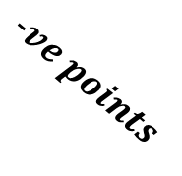
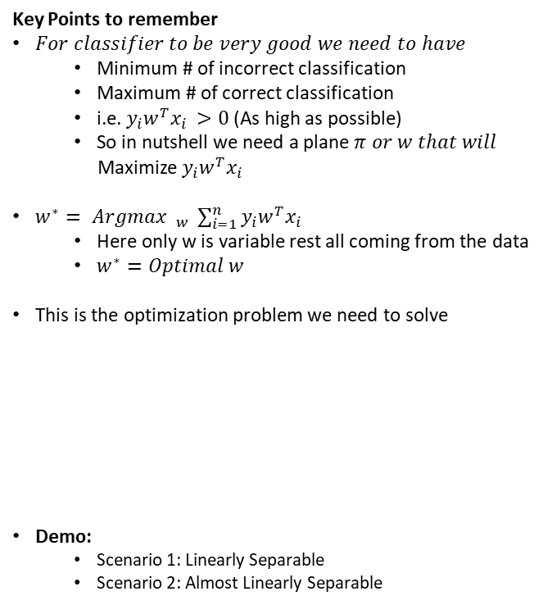
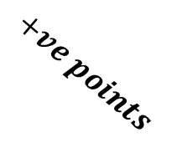


Geometric Intuition
Key Points to remember
$For classifier to be very good we need to have$
Minimum # of incorrect classification
Maximum # of correct classification
i.e. $y_{i}w^{T}x_{i }>0$(As high as possible)
So in nutshell we need a plane $π or w that will$
Maximize $y_{i}w^{T}x_{i }$
$w^{∗}= Argmax$ $_{w^{ }} \sum_{i=1}^{n}{y_{i}w^{T}x_{i }}$
Here only w is variable rest all coming from the data
$w^{∗}=Optimal w$
This is the optimization problem we need to solve
Demo:
Scenario 1: Linearly Separable
Scenario 2: Almost Linearly Separable
$$+ve points$$
$$Vector w$$
$$−ve points$$
$$d_{j}$$
$$x_{i}$$
$$d_{i}$$
$$x_{j}$$
$$π$$

Slide 5
Assessment
Q1. What is the assumption of Logistic Regression?
The distance between the points are the most important factor in the Logistic Regression.
The data should be linearly or almost linearly separable
Logistic Regression can work on any type of data there is no assumption as such
The points should be linear in nature

Slide 6

Assessment
Q2. Which if the following condition is True?
If $y_{i}= +1 \left(+ve\right) and w^{T}x_{i}>0 then y_{i}w^{T}x_{i }>0,$Plane is correctly classifying the point
If $y_{i}=−1 \left(−ve\right) and w^{T}x_{i}>0 then y_{i}w^{T}x_{i }>0,$Plane is correctly classifying the point
If $y_{i}= +1 \left(+ve\right) and w^{T}x_{i}<0 then y_{i}w^{T}x_{i }>0,$Plane is correctly classifying the point
If $y_{i}= +1 \left(+ve\right) and w^{T}x_{i}<0 then y_{i}w^{T}x_{i }<0,$Plane is correctly classifying the point

Slide 7
Assessment
Q3. In the equation of the plane $π= w^{T}x+b=0,$ which option is correct about w, x and b?
w and x are vectors and b is a scalar
w is a scalar, x and b are vectors
w and b are scalars and x is a vector
w and b are vectors and x is a scalar

Slide 8
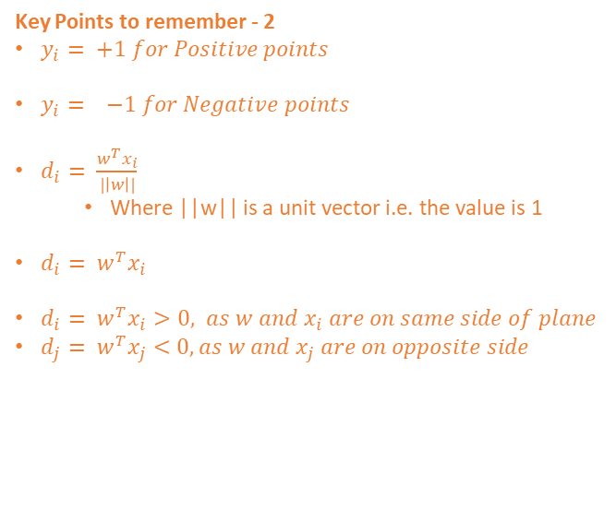
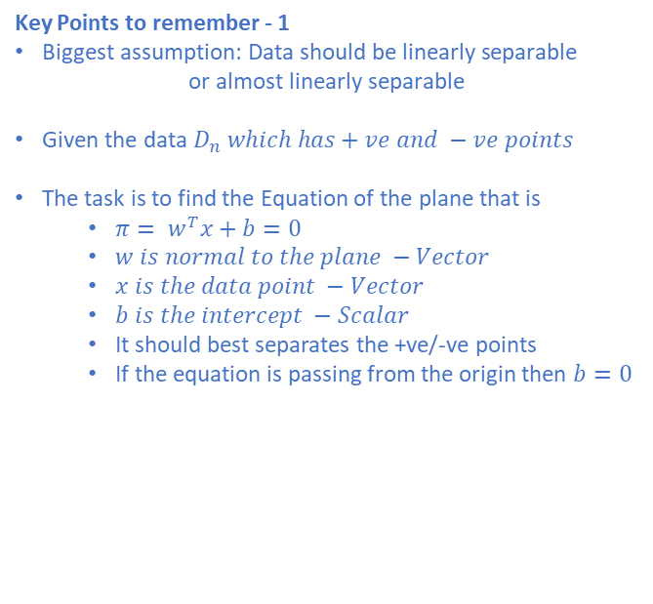

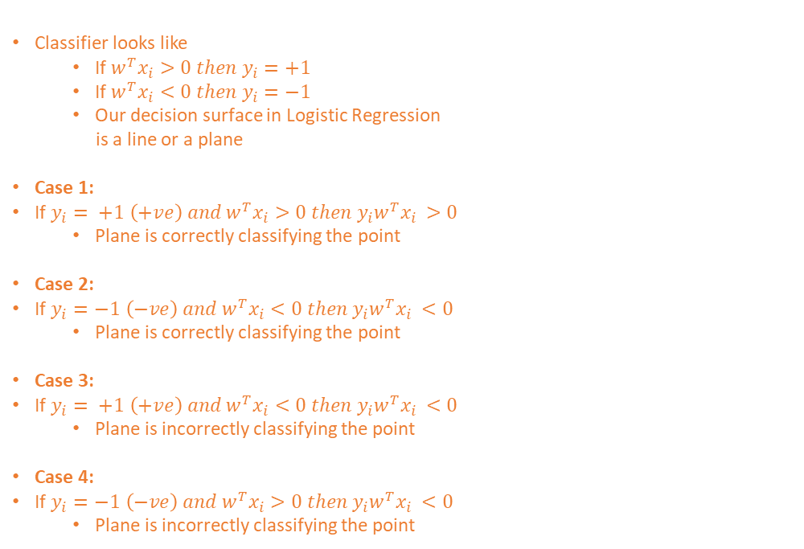
Logistic Regression – Geometric Intuition Cheat Sheet
Key Points to remember - 1
$\text{Biggest} \text{assumption}\text{: }\text{Data} \text{should} \text{be} \text{linearly} \text{separable}$
$$\text{or} \text{almost} \text{linearly} \text{separable}$$
$\text{Given} \text{the} \text{data} D_{n} which has+ve and −ve points$
The task is to find the Equation of the plane that is
$π= w^{T}x+b=0$
$w is normal to the plane −Vector$
$x is the data point −Vector$
$b is the intercept −Scalar$
It should best separates the +ve/-ve points
If the equation is passing from the origin then $b=0$
Classifier looks like
If $w^{T}x_{i}>0 then y_{i}=+1$
If $w^{T}x_{i}<0 then y_{i}=−1$
Our decision surface in Logistic Regression
is a line or a plane
Case 1:
If $y_{i}= +1 \left(+ve\right) and w^{T}x_{i}>0 then y_{i}w^{T}x_{i }>0$
Plane is correctly classifying the point
Case 2:
If $y_{i}=−1 \left(−ve\right) and w^{T}x_{i}<0 then y_{i}w^{T}x_{i }<0$
Plane is correctly classifying the point
Case 3:
If $y_{i}= +1 \left(+ve\right) and w^{T}x_{i}<0 then y_{i}w^{T}x_{i }<0$
Plane is incorrectly classifying the point
Case 4:
If $y_{i}=−1 \left(−ve\right) and w^{T}x_{i}>0 then y_{i}w^{T}x_{i }<0$
Plane is incorrectly classifying the point
Key Points to remember - 3
$For classifier to be very good we need to have$
Minimum # of incorrect classification
Maximum # of correct classification
i.e. $y_{i}w^{T}x_{i }>0$(As high as possible)
So in nutshell we need a plane $π or w that will$
Maximize $y_{i}w^{T}x_{i }$
$w^{∗}= Argmax$ $_{w^{ }} \sum_{i=1}^{n}{y_{i}w^{T}x_{i }}$
Here only w is variable rest all coming from the data
$w^{∗}=Optimal w$
This is the optimization problem we need to solve
Key Points to remember - 2
$y_{i}= +1 for Positive points$
$y_{i}= −1 for Negative points$
$d_{i}= \frac{w^{T}x_{i}}{|\left|w\right||}$
Where ||w|| is a unit vector i.e. the value is 1
$d_{i}= w^{T}x_{i}$
$d_{i}= w^{T}x_{i}>0, as w and x_{i} are on same side of plane$
$d_{j}= w^{T}x_{j}<0, as w and x_{j} are on opposite side$

Slide 9
Sigmoid Function
Squashing

Slide 10

Quick Understanding
Key Points to remember
$w^{∗}= Argmax$ $_{w^{ }} \sum_{i=1}^{n}{y_{i}w^{T}x_{i }}$
Here only w is variable rest all coming from the data
$w^{∗}=Optimal w$
$y_{i}w^{T}x_{i }$ +ve then correctly classified points
$y_{i}w^{T}x_{i }$ - ve then incorrectly classified points
$y_{i}w^{T}x_{i }$(Lets call it as signed distance)
$$Vector w$$
$$π$$

Slide 11





Case 1: Fail Scenarios – Impact of Outliers
Key Points to remember
$w^{∗}= Argmax$ $_{w^{ }} \sum_{i=1}^{n}{y_{i}w^{T}x_{i }}$
Here only w is variable rest all coming from the data
$w^{∗}=Optimal w$
$y_{i}w^{T}x_{i }$ +ve then correctly classified points
$y_{i}w^{T}x_{i }$ - ve then incorrectly classified points
$y_{i}w^{T}x_{i }$(Lets call it as signed distance)
$$d_{i}=50$$
$$Vector w$$
$$d_{i}=1$$
$$π _{1}$$
$$d_{i}=1$$

Slide 12




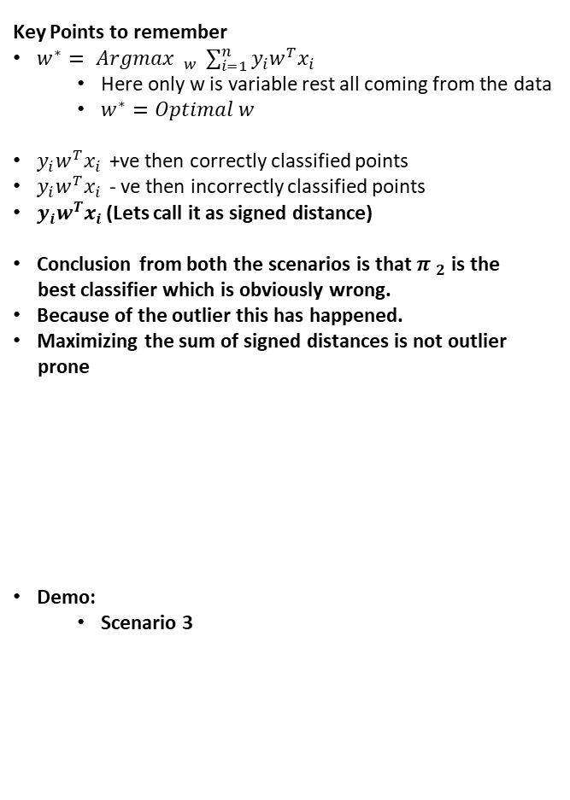





Case 2: Fail Scenarios – Impact of Outliers
Key Points to remember
$w^{∗}= Argmax$ $_{w^{ }} \sum_{i=1}^{n}{y_{i}w^{T}x_{i }}$
Here only w is variable rest all coming from the data
$w^{∗}=Optimal w$
$y_{i}w^{T}x_{i }$ +ve then correctly classified points
$y_{i}w^{T}x_{i }$ - ve then incorrectly classified points
$y_{i}w^{T}x_{i }$(Lets call it as signed distance)
Conclusion from both the scenarios is that $π _{2}$ is the
best classifier which is obviously wrong.
Because of the outlier this has happened.
Maximizing the sum of signed distances is not outlier
prone
Demo:
Scenario 3
$$π _{2}$$
$d_{i}=$6
$$d_{i}=1$$
$d_{i}=$5
$d_{i}=$4
$d_{i}=$3
$d_{i}=$2
$$d_{i}=1$$
$$Vector w$$

Slide 13
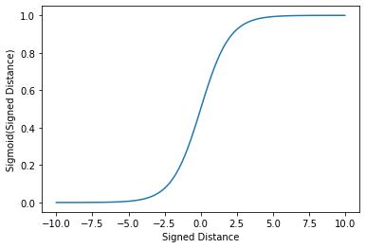
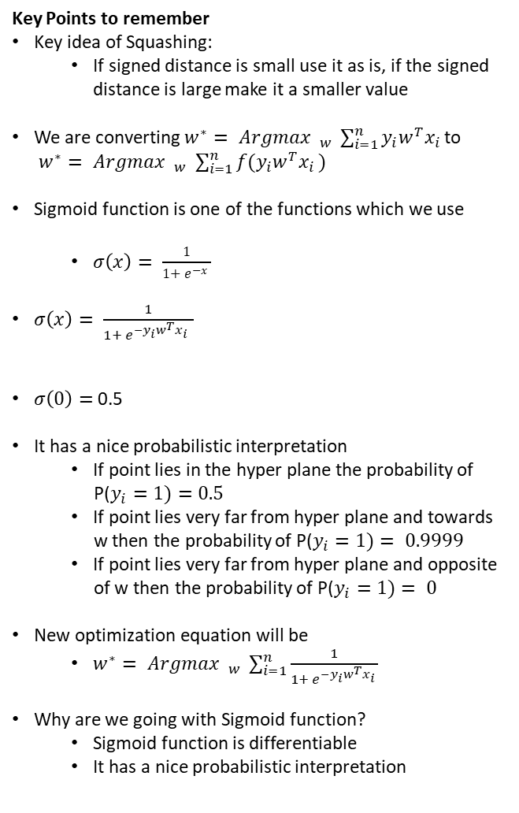
Squashing
Key Points to remember
Key idea of Squashing:
If signed distance is small use it as is, if the signed
distance is large make it a smaller value
We are converting $w^{∗}= Argmax$ $_{w^{ }} \sum_{i=1}^{n}{y_{i}w^{T}x_{i }}$to
$w^{∗}= Argmax$ $_{w^{ }} \sum_{i=1}^{n}{{f(y}_{i}w^{T}x_{i })}$
Sigmoid function is one of the functions which we use
$σ\left(x\right)= \frac{1}{1+ e^{−x} }$
$σ\left(x\right)= \frac{1}{1+ e^{−y_{i}w^{T}x_{i }} }$
$σ\left(0\right)=$ 0.5
It has a nice probabilistic interpretation
If point lies in the hyper plane the probability of
P($y_{i}=1)=0.5$
If point lies very far from hyper plane and towards
w then the probability of P($y_{i}=1)= 0.9999$
If point lies very far from hyper plane and opposite
of w then the probability of P($y_{i}=1)= 0$
New optimization equation will be
$w^{∗}= Argmax$ $_{w^{ }} \sum_{i=1}^{n}{\frac{1}{1+ e^{−y_{i}w^{T}x_{i }}}}$
Why are we going with Sigmoid function?
Sigmoid function is differentiable
It has a nice probabilistic interpretation

Slide 14
Assessment
Q1. What is problem with the signed distance approach?
It is impacted highly with the outliers
There is no issue with signed distance it is just to make things faster we are going with Sigmoid approach
Signed distance slows down the performance of the model
None of the above

Slide 15
Assessment
Q2. Why are we using Sigmoid transformation?
Sigmoid transformation has nice probabilistic interpretation
Sigmoid transformation comes up with good predictions when outliers are present in the dataset
Sigmoid function is differentiable
All of the above

Slide 16
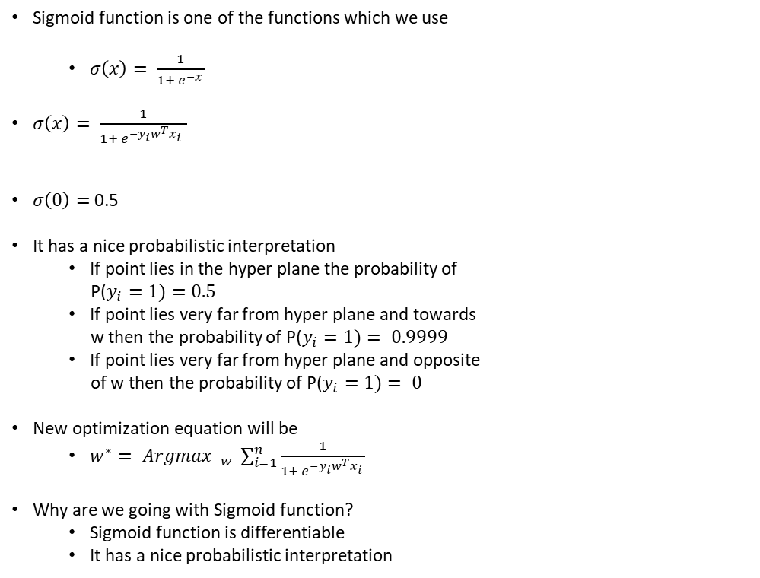
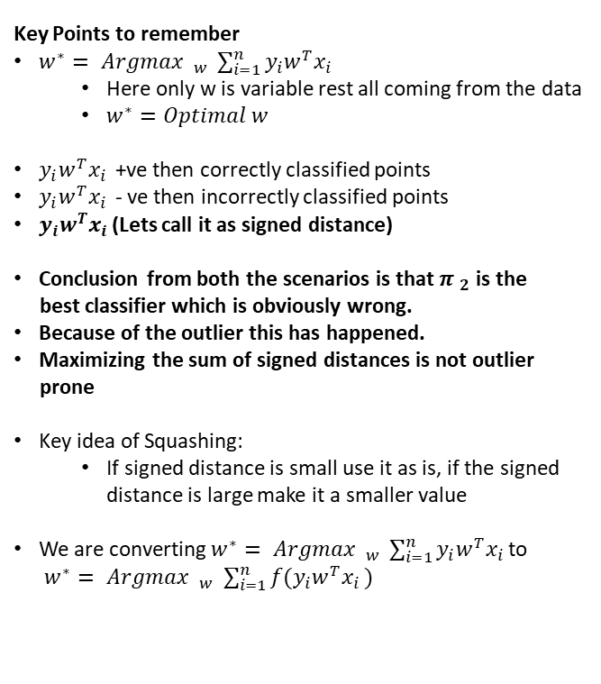
Logistic Regression – Squashing Cheat Sheet
Key Points to remember
$w^{∗}= Argmax$ $_{w^{ }} \sum_{i=1}^{n}{y_{i}w^{T}x_{i }}$
Here only w is variable rest all coming from the data
$w^{∗}=Optimal w$
$y_{i}w^{T}x_{i }$ +ve then correctly classified points
$y_{i}w^{T}x_{i }$ - ve then incorrectly classified points
$y_{i}w^{T}x_{i }$(Lets call it as signed distance)
Conclusion from both the scenarios is that $π _{2}$ is the
best classifier which is obviously wrong.
Because of the outlier this has happened.
Maximizing the sum of signed distances is not outlier
prone
Key idea of Squashing:
If signed distance is small use it as is, if the signed
distance is large make it a smaller value
We are converting $w^{∗}= Argmax$ $_{w^{ }} \sum_{i=1}^{n}{y_{i}w^{T}x_{i }}$to
$w^{∗}= Argmax$ $_{w^{ }} \sum_{i=1}^{n}{{f(y}_{i}w^{T}x_{i })}$
Sigmoid function is one of the functions which we use
$σ\left(x\right)= \frac{1}{1+ e^{−x} }$
$σ\left(x\right)= \frac{1}{1+ e^{−y_{i}w^{T}x_{i }} }$
$σ\left(0\right)=$ 0.5
It has a nice probabilistic interpretation
If point lies in the hyper plane the probability of
P($y_{i}=1)=0.5$
If point lies very far from hyper plane and towards
w then the probability of P($y_{i}=1)= 0.9999$
If point lies very far from hyper plane and opposite
of w then the probability of P($y_{i}=1)= 0$
New optimization equation will be
$w^{∗}= Argmax$ $_{w^{ }} \sum_{i=1}^{n}{\frac{1}{1+ e^{−y_{i}w^{T}x_{i }}}}$
Why are we going with Sigmoid function?
Sigmoid function is differentiable
It has a nice probabilistic interpretation

Slide 17
Mathematical Formulation
Objective Function

Slide 18
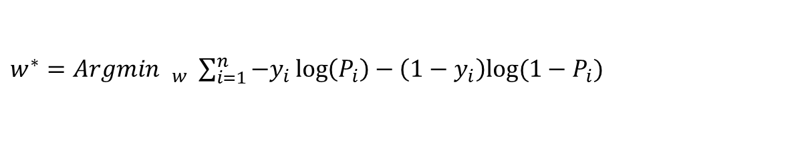
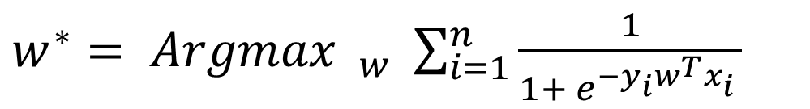
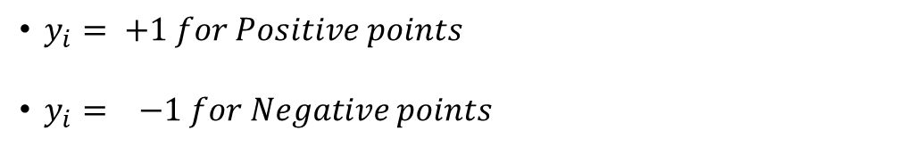
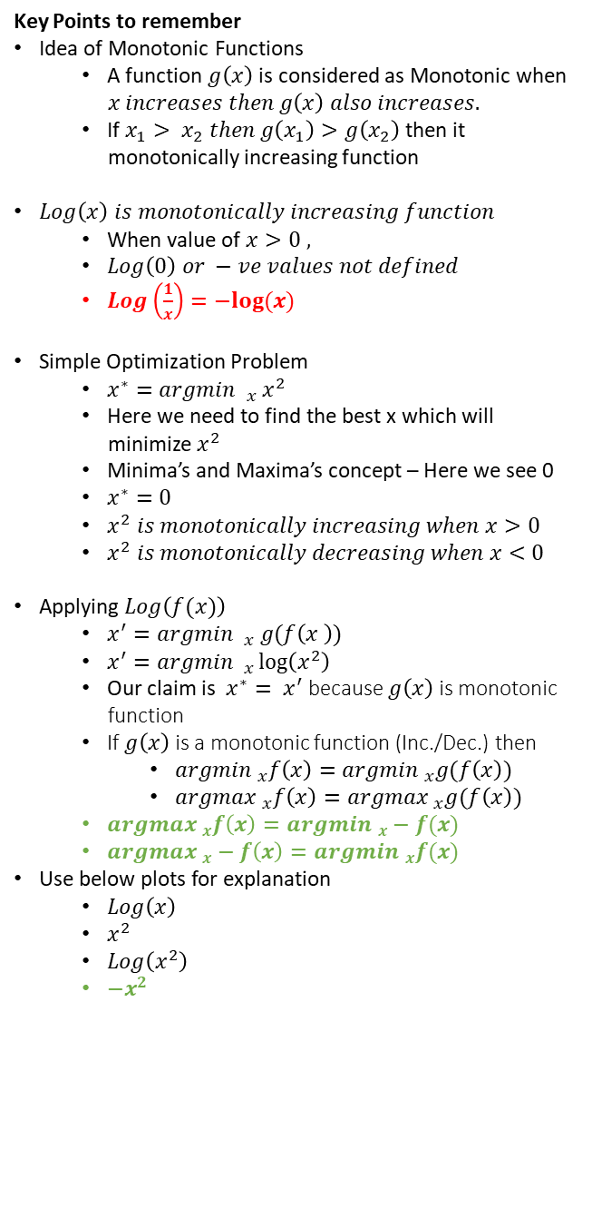
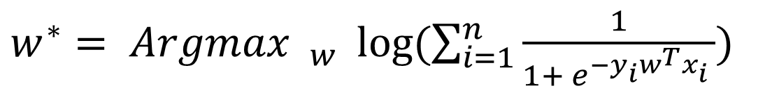
Optimization Problem
Key Points to remember
Idea of Monotonic Functions
A function $g\left(x\right)$ is considered as Monotonic when
$x increases then g\left(x\right) also increases.$
If $x_{1}> x_{2} then g\left(x_{1}\right)>g\left(x_{2}\right)$then it
monotonically increasing function
$Log\left(x\right) is monotonically increasing function$
When value of $x>0 ,$
$Log\left(0\right) or −ve values not defined$
$Log\left(\frac{1}{x}\right)=−log⁡(x)$
Simple Optimization Problem
$x^{∗}=argmin _{x} x^{2}$
Here we need to find the best x which will
minimize $x^{2}$
Minima’s and Maxima’s concept – Here we see 0
$x^{∗}=0$
$x^{2} is monotonically increasing when x>0$
$x^{2} is monotonically decreasing when x<0$
Applying $Log\left(f(x)\right)$
$x^{′}=argmin _{x} g(f\left(x^{ }\right))$
$x^{′}=argmin _{x}\log\left(x^{2}\right)$
Our claim is $x^{∗}= x^{′}$ because $g\left(x\right)$is monotonic
function
If $g\left(x\right)$is a monotonic function (Inc./Dec.) then
$argmin _{x}f\left(x\right)=argmin _{x}g(f\left(x\right))$
$argmax _{x}f\left(x\right)=argmax _{x}g(f\left(x\right))$
$argmax _{x}f\left(x\right)=argmin _{x}−f(x)$
$argmax _{x}−f\left(x\right)=argmin _{x}f(x)$
Use below plots for explanation
$Log\left(x\right)$
$x^{2}$
$Log\left(x^{2}\right)$
$−x^{2}$
$w^{∗}= Argmax$ $_{w^{ }} \sum_{i=1}^{n}{\frac{1}{1+ e^{−y_{i}w^{T}x_{i }}}}$
$w^{∗}= Argmax$ $_{w^{ }} log⁡(\sum_{i=1}^{n}{\frac{1}{1+ e^{−y_{i}w^{T}x_{i }}})}$
$w^{∗}= Argmax$ $_{w^{ }}− log⁡(\sum_{i=1}^{n}{1+e^{−y_{i}w^{T}x_{i}} )}$
$w^{∗}=Argmin$ $_{w^{ }} log⁡(\sum_{i=1}^{n}{1+e^{−y_{i}w^{T}x_{i}} )}$
If 1 is not there then it is nothing but signed distance
$y_{i}= +1 for Positive points$
$y_{i}= −1 for Negative points$
$w^{∗}=Argmin$ $_{w^{ }} \sum_{i=1}^{n}{−y_{i}}\log\left(P_{i}\right)−\left(1−y_{i}\right)log⁡(1−P_{i})$
$P_{i}=σ(w^{T}x_{i})$, here $y_{i}=0/1$, above equation is probabilistic approach

Slide 19

Assessment
Q1. What is the property of monotonic function?
If $f\left(x\right)increases then g\left(f\left(x\right)\right) decreases$
If $f\left(x\right)increases then g\left(f\left(x\right)\right) will be constant$
If $f\left(x\right)increases then g\left(f\left(x\right)\right) increases$
If $f\left(x\right)increases then g\left(f\left(x\right)\right) becomes 0$

Slide 20

Assessment
Q2. In the geometric interpretation on Logistic regression what is the value of $y_{i}?$
$y_{i} varies from 0 to 1$
$y_{i} varies from −1 to 1$
$y_{i} varies from −∞ to 1$
$y_{i} varies from −∞ to+∞$

Slide 21
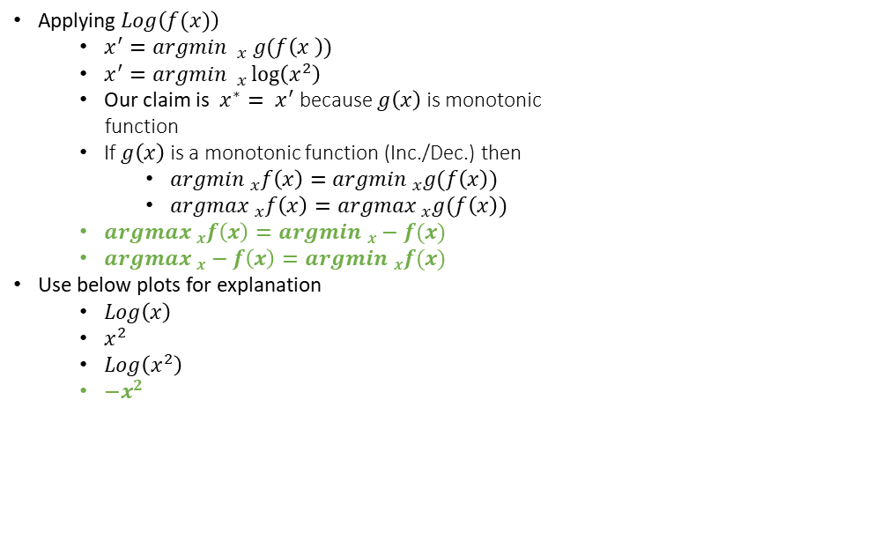
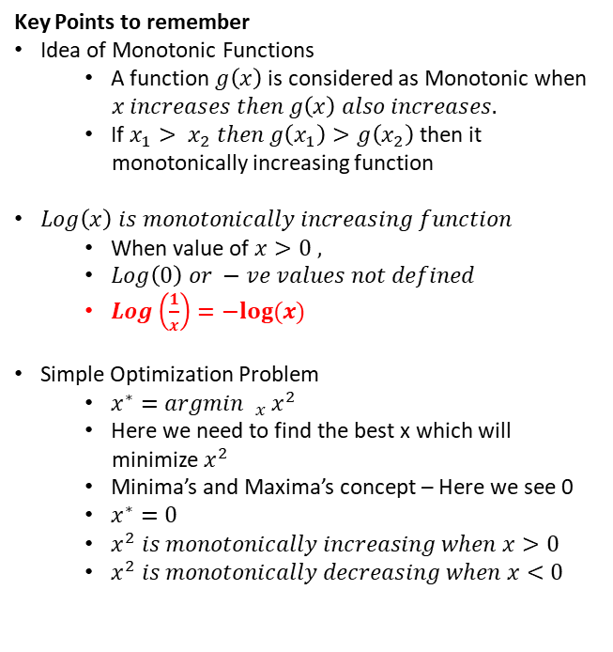
Logistic Regression - Optimization Problem Cheat Sheet
Key Points to remember
Idea of Monotonic Functions
A function $g\left(x\right)$ is considered as Monotonic when
$x increases then g\left(x\right) also increases.$
If $x_{1}> x_{2} then g\left(x_{1}\right)>g\left(x_{2}\right)$then it
monotonically increasing function
$Log\left(x\right) is monotonically increasing function$
When value of $x>0 ,$
$Log\left(0\right) or −ve values not defined$
$Log\left(\frac{1}{x}\right)=−log⁡(x)$
Simple Optimization Problem
$x^{∗}=argmin _{x} x^{2}$
Here we need to find the best x which will
minimize $x^{2}$
Minima’s and Maxima’s concept – Here we see 0
$x^{∗}=0$
$x^{2} is monotonically increasing when x>0$
$x^{2} is monotonically decreasing when x<0$
Applying $Log\left(f(x)\right)$
$x^{′}=argmin _{x} g(f\left(x^{ }\right))$
$x^{′}=argmin _{x}\log\left(x^{2}\right)$
Our claim is $x^{∗}= x^{′}$ because $g\left(x\right)$is monotonic
function
If $g\left(x\right)$is a monotonic function (Inc./Dec.) then
$argmin _{x}f\left(x\right)=argmin _{x}g(f\left(x\right))$
$argmax _{x}f\left(x\right)=argmax _{x}g(f\left(x\right))$
$argmax _{x}f\left(x\right)=argmin _{x}−f(x)$
$argmax _{x}−f\left(x\right)=argmin _{x}f(x)$
Use below plots for explanation
$Log\left(x\right)$
$x^{2}$
$Log\left(x^{2}\right)$
$−x^{2}$

Slide 22
Weight Vector
How to interpret?

Slide 23
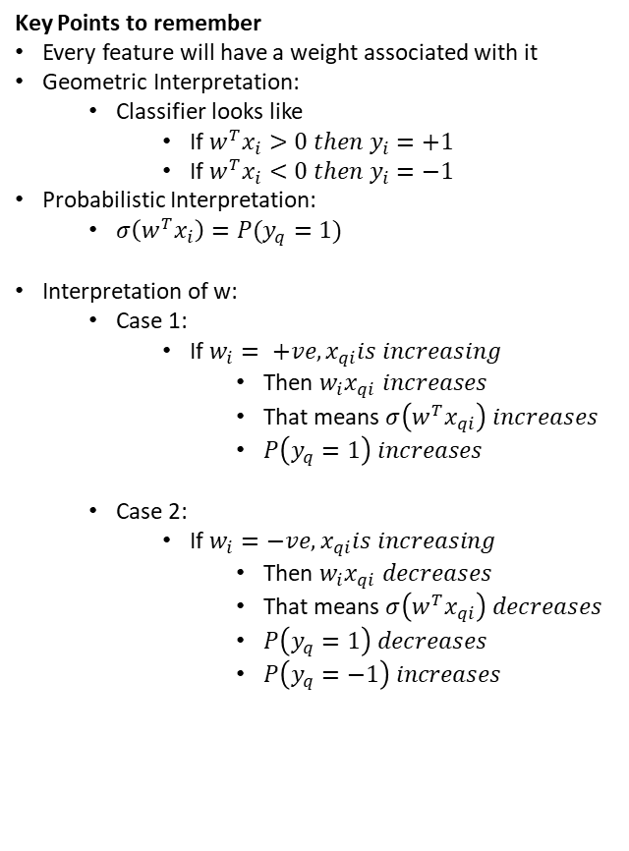
Weight Vector
Key Points to remember
Every feature will have a weight associated with it
Geometric Interpretation:
Classifier looks like
If $w^{T}x_{i}>0 then y_{i}=+1$
If $w^{T}x_{i}<0 then y_{i}=−1$
Probabilistic Interpretation:
$σ\left(w^{T}x_{i}\right)=P(y_{q}=1)$
Interpretation of w:
Case 1:
If $w_{i}= +ve, x_{qi}is increasing$
Then $w_{i}x_{qi} increases$
That means $σ\left(w^{T}x_{qi}\right) increases$
$P\left(y_{q}=1\right) increases$
Case 2:
If $w_{i}=−ve, x_{qi}is increasing$
Then $w_{i}x_{qi} decreases$
That means $σ\left(w^{T}x_{qi}\right) decreases$
$P\left(y_{q}=1\right) decreases$
$P\left(y_{q}=−1\right) increases$
$w^{∗}=Argmin$ $_{w^{ }} log⁡(\sum_{i=1}^{n}{1+e^{−y_{i}w^{T}x_{i}} )}$
Weight Vector
Size of weight vector same as number of dimensions

Slide 24
Assessment
Q1. When the weight $w_{i} is+ve and x_{qi}$is low what will be the probability of ${P(y}_{i}=1)?$
High
Low
Towards 0.5

Slide 25
Assessment
Q2. When the weight $w_{i} is+ve and x_{qi}$is high what will be the probability of ${P(y}_{i}=1)?$
High
Low
Towards 0.5

Slide 26
Assessment
Q3. When the weight $w_{i} is −ve and x_{qi}$is high what will be the probability of ${P(y}_{i}=1)?$
High
Low
Towards 0.5

Slide 27
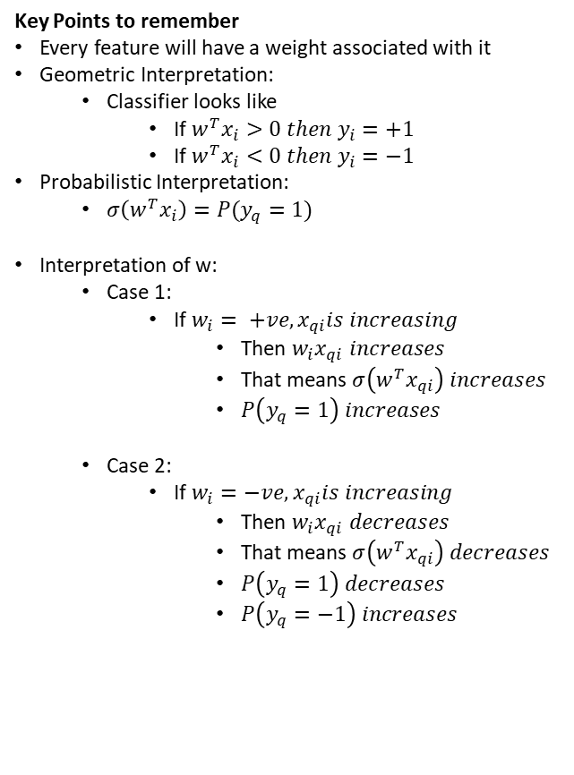
Logistic Regression – Weight Vector Cheat Sheet
Key Points to remember
Every feature will have a weight associated with it
Geometric Interpretation:
Classifier looks like
If $w^{T}x_{i}>0 then y_{i}=+1$
If $w^{T}x_{i}<0 then y_{i}=−1$
Probabilistic Interpretation:
$σ\left(w^{T}x_{i}\right)=P(y_{q}=1)$
Interpretation of w:
Case 1:
If $w_{i}= +ve, x_{qi}is increasing$
Then $w_{i}x_{qi} increases$
That means $σ\left(w^{T}x_{qi}\right) increases$
$P\left(y_{q}=1\right) increases$
Case 2:
If $w_{i}=−ve, x_{qi}is increasing$
Then $w_{i}x_{qi} decreases$
That means $σ\left(w^{T}x_{qi}\right) decreases$
$P\left(y_{q}=1\right) decreases$
$P\left(y_{q}=−1\right) increases$

Slide 28
L2 Regularization
Overfitting vs. Underfitting

Slide 29
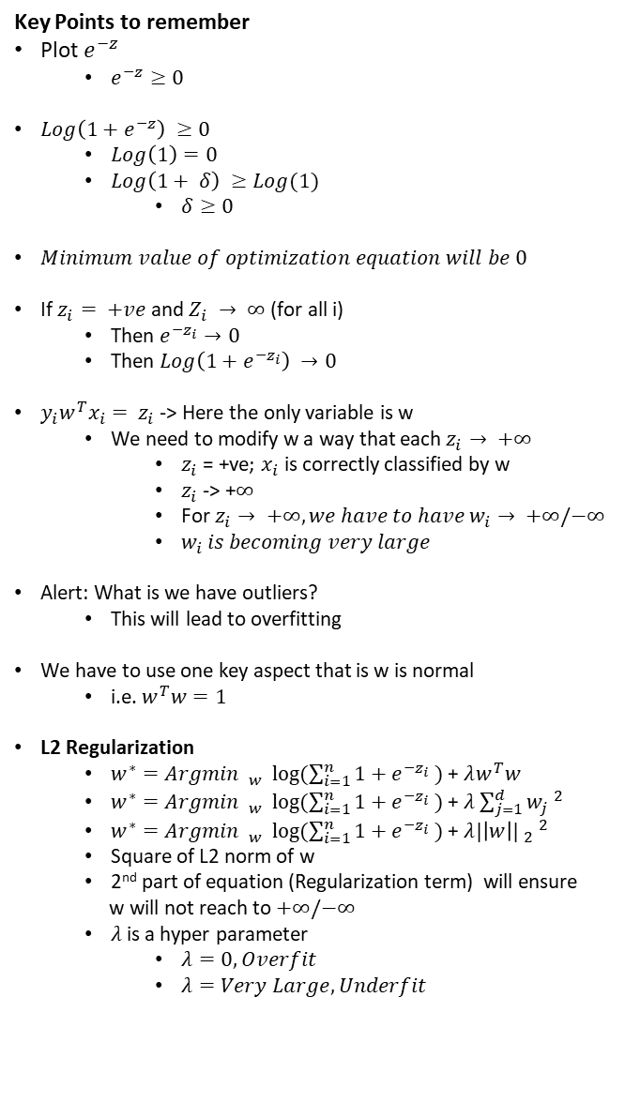

L2 Regularization
Key Points to remember
Plot $e^{−z}$
$e^{−z}≥0$
$Log\left(1+e^{−z}\right) ≥0$
$Log\left(1\right)=0$
$Log\left(1+ δ\right) ≥Log(1)$
$δ≥0$
$Minimum value of optimization equation will be 0$
If $z_{i}= +ve$ and $Z_{i} → ∞$ (for all i)
Then $e^{−z_{i}}→0$
Then $Log\left(1+e^{−z_{i}}\right) →0$
$y_{i}w^{T}x_{i}= z_{i}$ -> Here the only variable is w
We need to modify w a way that each $z_{i}→ +∞$
$z_{i}$ = +ve; $x_{i}$ is correctly classified by w
$z_{i}$ -> +$∞$
For $z_{i}→ +∞, we have to have w_{i}→ +∞/−∞$
$w_{i }is becoming very large$
Alert: What is we have outliers?
This will lead to overfitting
We have to use one key aspect that is w is normal
i.e. $w^{T}w=1$
L2 Regularization
$w^{∗}=Argmin$ $_{w^{ }} log⁡(\sum_{i=1}^{n}{1+e^{−z_{i}} )}$ + $λw^{T}w$
$w^{∗}=Argmin$ $_{w^{ }} log⁡(\sum_{i=1}^{n}{1+e^{−z_{i}} )}$ + $λ\sum_{j=1}^{d}{w_{j} ^{2}}$
$w^{∗}=Argmin$ $_{w^{ }} log⁡(\sum_{i=1}^{n}{1+e^{−z_{i}} )}$ + $λ|\left|w\right|| _{2} ^{2}$
Square of L2 norm of w
2nd part of equation (Regularization term) will ensure
w will not reach to $+∞/−∞$
$λ$is a hyper parameter
$λ=0, Overfit$
$λ=Very Large, Underfit$
$w^{∗}=Argmin$ $_{w^{ }} log⁡(\sum_{i=1}^{n}{1+e^{−y_{i}w^{T}x_{i}} )}$
Weight Vector
Let’s say $y_{i}w^{T}x_{i}= z_{i}$
$w^{∗}=Argmin$ $_{w^{ }} log⁡(\sum_{i=1}^{n}{1+e^{−z_{i}} )}≥0$
$w^{∗}=Argmin$ $_{w^{ }} log⁡(\sum_{i=1}^{n}{1+e^{−z_{i}} )}+λ|\left|w\right|| _{2} ^{2}$
Tug of war

Slide 30
Assessment
Q1. Why regularization is required$?$
So that the model will not be underfit
So that the model will not be overfit
So that the model will not be overfit as well as underfit
None of the above

Slide 31

Assessment
Q2. What will happen when the value of $λ$is equal to 0?
The model will be underfit
The model will be overfit
$λ$ is not really taking care of overfitting and underfitting
None of the above

Slide 32
Assessment
Q3. What will happen when the value of $λ$is very high?
The model will be underfit
The model will be overfit
$λ$ is not really taking care of overfitting and underfitting
None of the above

Slide 33
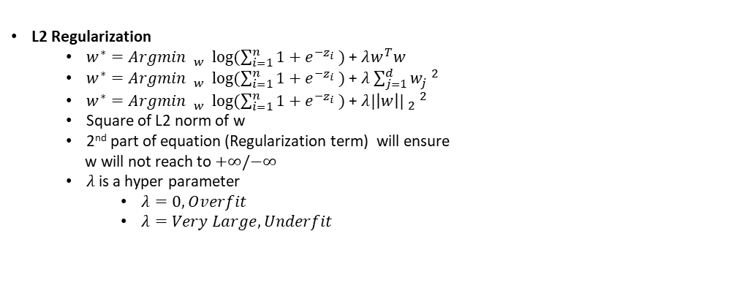
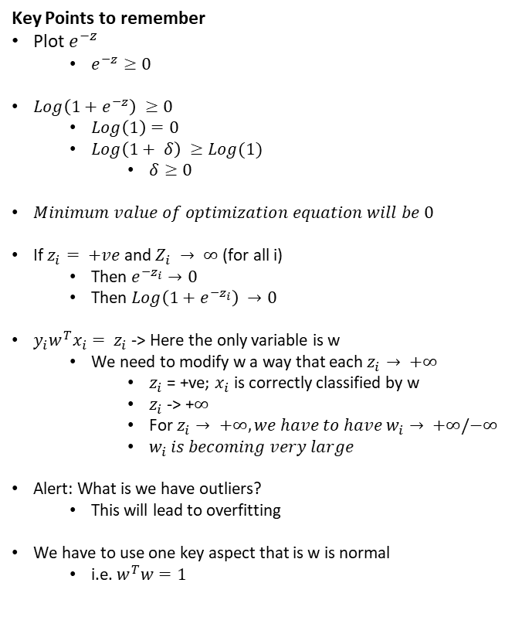
Logistic Regression – L2 Regularization Cheat Sheet
Key Points to remember
Plot $e^{−z}$
$e^{−z}≥0$
$Log\left(1+e^{−z}\right) ≥0$
$Log\left(1\right)=0$
$Log\left(1+ δ\right) ≥Log(1)$
$δ≥0$
$Minimum value of optimization equation will be 0$
If $z_{i}= +ve$ and $Z_{i} → ∞$ (for all i)
Then $e^{−z_{i}}→0$
Then $Log\left(1+e^{−z_{i}}\right) →0$
$y_{i}w^{T}x_{i}= z_{i}$ -> Here the only variable is w
We need to modify w a way that each $z_{i}→ +∞$
$z_{i}$ = +ve; $x_{i}$ is correctly classified by w
$z_{i}$ -> +$∞$
For $z_{i}→ +∞, we have to have w_{i}→ +∞/−∞$
$w_{i }is becoming very large$
Alert: What is we have outliers?
This will lead to overfitting
We have to use one key aspect that is w is normal
i.e. $w^{T}w=1$
L2 Regularization
$w^{∗}=Argmin$ $_{w^{ }} log⁡(\sum_{i=1}^{n}{1+e^{−z_{i}} )}$ + $λw^{T}w$
$w^{∗}=Argmin$ $_{w^{ }} log⁡(\sum_{i=1}^{n}{1+e^{−z_{i}} )}$ + $λ\sum_{j=1}^{d}{w_{j} ^{2}}$
$w^{∗}=Argmin$ $_{w^{ }} log⁡(\sum_{i=1}^{n}{1+e^{−z_{i}} )}$ + $λ|\left|w\right|| _{2} ^{2}$
Square of L2 norm of w
2nd part of equation (Regularization term) will ensure
w will not reach to $+∞/−∞$
$λ$is a hyper parameter
$λ=0, Overfit$
$λ=Very Large, Underfit$

Slide 34
L1 Regularization
Understand the sparsity

Slide 35
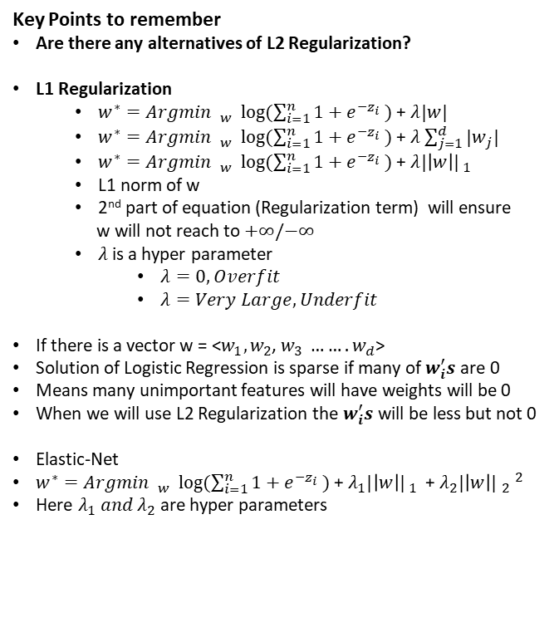
L1 Regularization
Key Points to remember
Are there any alternatives of L2 Regularization?
L1 Regularization
$w^{∗}=Argmin$ $_{w^{ }} log⁡(\sum_{i=1}^{n}{1+e^{−z_{i}} )}$ + $λ|w|$
$w^{∗}=Argmin$ $_{w^{ }} log⁡(\sum_{i=1}^{n}{1+e^{−z_{i}} )}$ + $λ\sum_{j=1}^{d}{{|w}_{j}| ^{ }}$
$w^{∗}=Argmin$ $_{w^{ }} log⁡(\sum_{i=1}^{n}{1+e^{−z_{i}} )}$ + $λ|\left|w\right|| _{1} ^{ }$
L1 norm of w
2nd part of equation (Regularization term) will ensure
w will not reach to $+∞/−∞$
$λ$is a hyper parameter
$λ=0, Overfit$
$λ=Very Large, Underfit$
If there is a vector w = <$w_{1},w_{2}$, $w_{3} …….w_{d}$>
Solution of Logistic Regression is sparse if many of $w_{i}^{′}s$are 0
Means many unimportant features will have weights will be 0
When we will use L2 Regularization the $w_{i}^{′}s$ will be less but not 0
Elastic-Net
$w^{∗}=Argmin$ $_{w^{ }} log⁡(\sum_{i=1}^{n}{1+e^{−z_{i}} )}$ + $λ_{1}|\left|w\right|| _{1} ^{ }$+ $λ_{2}|\left|w\right|| _{2} ^{2}$
Here $λ_{1} and λ_{2}$are hyper parameters
$w^{∗}=Argmin$ $_{w^{ }} log⁡(\sum_{i=1}^{n}{1+e^{−z_{i}} )}+λ|\left|w\right|| _{1} ^{ }$

Slide 36

Assessment
Q1. What is the difference between L1 Regularization and L2 Regularization?
L1 Regularization leads to all the unimportant weights as $∞$
L2 Regularization leads to all the unimportant weights as $∞$
L2 Regularization leads to all the unimportant weights as $0$
L1 Regularization leads to all the unimportant weights as $0$

Slide 37
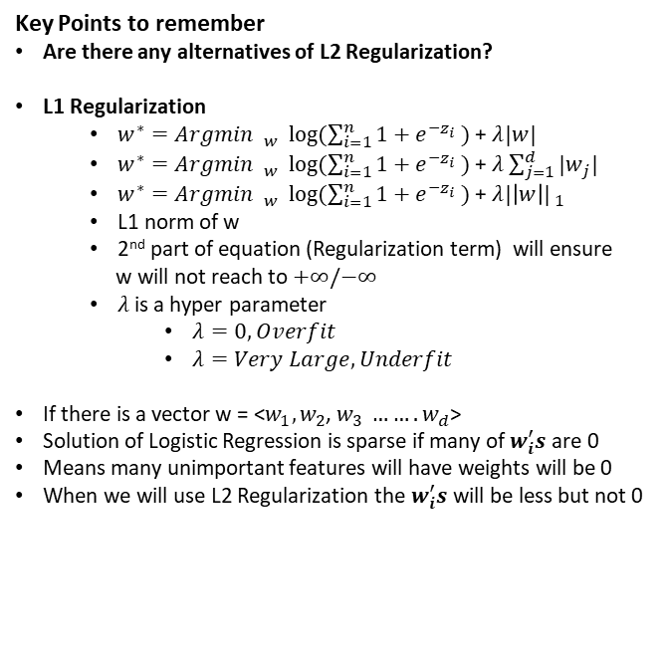
Logistic Regression – L2 Regularization Cheat Sheet
Key Points to remember
Are there any alternatives of L2 Regularization?
L1 Regularization
$w^{∗}=Argmin$ $_{w^{ }} log⁡(\sum_{i=1}^{n}{1+e^{−z_{i}} )}$ + $λ|w|$
$w^{∗}=Argmin$ $_{w^{ }} log⁡(\sum_{i=1}^{n}{1+e^{−z_{i}} )}$ + $λ\sum_{j=1}^{d}{{|w}_{j}| ^{ }}$
$w^{∗}=Argmin$ $_{w^{ }} log⁡(\sum_{i=1}^{n}{1+e^{−z_{i}} )}$ + $λ|\left|w\right|| _{1} ^{ }$
L1 norm of w
2nd part of equation (Regularization term) will ensure
w will not reach to $+∞/−∞$
$λ$is a hyper parameter
$λ=0, Overfit$
$λ=Very Large, Underfit$
If there is a vector w = <$w_{1},w_{2}$, $w_{3} …….w_{d}$>
Solution of Logistic Regression is sparse if many of $w_{i}^{′}s$are 0
Means many unimportant features will have weights will be 0
When we will use L2 Regularization the $w_{i}^{′}s$ will be less but not 0

Slide 38
Probabilistic Interpretation
Logistic Regression

Slide 39
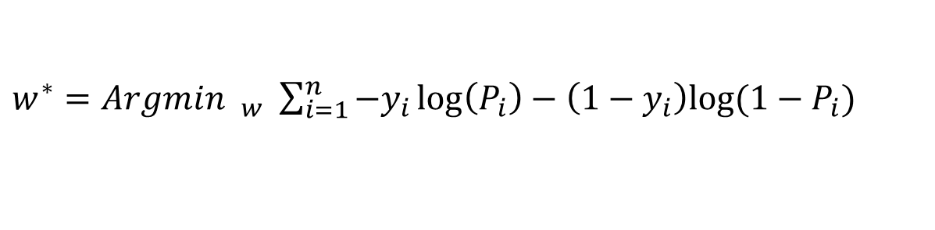
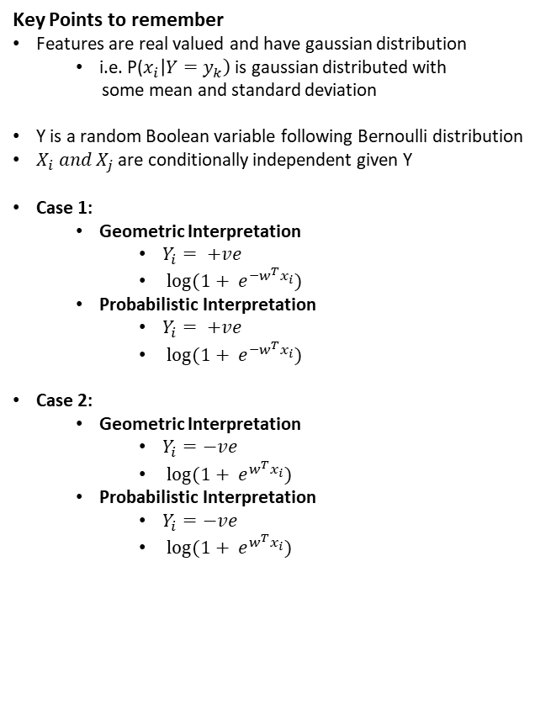
Probabilistic Interpretation
Key Points to remember
Features are real valued and have gaussian distribution
i.e. P($x_{i}\left|Y=y_{k}\right)$ is gaussian distributed with
some mean and standard deviation
Y is a random Boolean variable following Bernoulli distribution
$X_{i} and X_{j}$are conditionally independent given Y
Case 1:
Geometric Interpretation
$Y_{i}= +ve$
$log⁡(1+ e^{−w^{T}x_{i}})$
Probabilistic Interpretation
$Y_{i}= +ve$
$log⁡(1+ e^{−w^{T}x_{i}})$
Case 2:
Geometric Interpretation
$Y_{i}=−ve$
$log⁡(1+ e^{w^{T}x_{i}})$
Probabilistic Interpretation
$Y_{i}=−ve$
$log⁡(1+ e^{w^{T}x_{i}})$
$w^{∗}=Argmin$ $_{w^{ }} \sum_{i=1}^{n}{−y_{i}}\log\left(P_{i}\right)−\left(1−y_{i}\right)log⁡(1−P_{i})$
$P_{i}=σ(w^{T}x_{i})$, here $y_{i}=0/1$, above equation is probabilistic approach
$w^{∗}=Argmin$ $_{w^{ }} log⁡(\sum_{i=1}^{n}{1+e^{−y_{i}w^{T}x_{i}} )}$
here $y_{i}=−1/1$, above equation is Geometric approach

Slide 40
Loss Minimization Interpretation
Logistic Regression

Slide 41
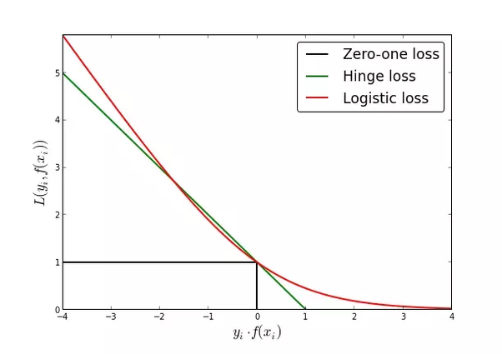
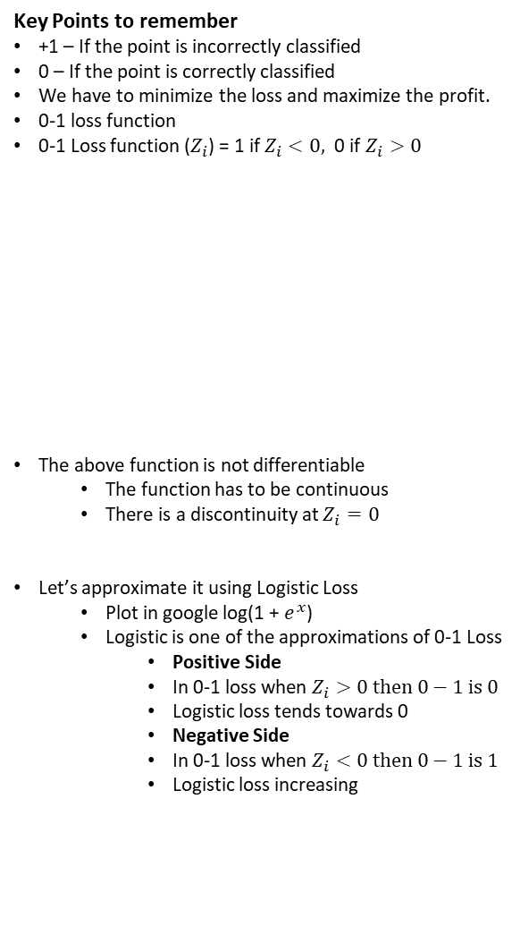

Loss Minimization Interpretation
Key Points to remember
+1 – If the point is incorrectly classified
0 – If the point is correctly classified
We have to minimize the loss and maximize the profit.
0-1 loss function
0-1 Loss function ($Z_{i}$) = 1 if $Z_{i}<0,$ 0 if $Z_{i}>0$
The above function is not differentiable
The function has to be continuous
There is a discontinuity at $Z_{i}=0$
Let’s approximate it using Logistic Loss
Plot in google log(1 + $e^{x}$)
Logistic is one of the approximations of 0-1 Loss
Positive Side
In 0-1 loss when $Z_{i}>0 then 0−1 is 0$
Logistic loss tends towards 0
Negative Side
In 0-1 loss when $Z_{i}<0 then 0−1 is 1$
Logistic loss increasing
$w^{∗}=Argmin$ $_{w^{ }} log⁡(\sum_{i=1}^{n}{1+e^{−y_{i}w^{T}x_{i}} )}$
Loss Function
$w^{∗}=Argmin$ $_{w^{ }} Number of incorrectly classified points$
$$Z_{i}$$
Source: https://www.quora.com/Why-does-the-logistic-regression-cost-function-work

Slide 42
Hyper Parameters Search
Grid Search and Random Search

Slide 43
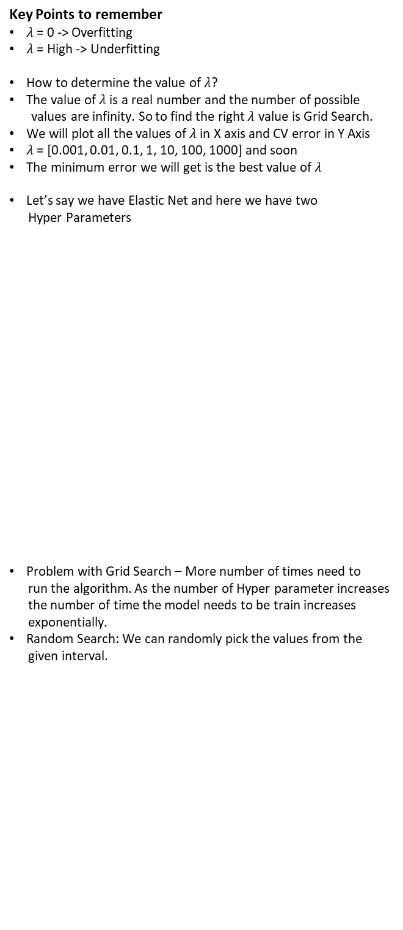
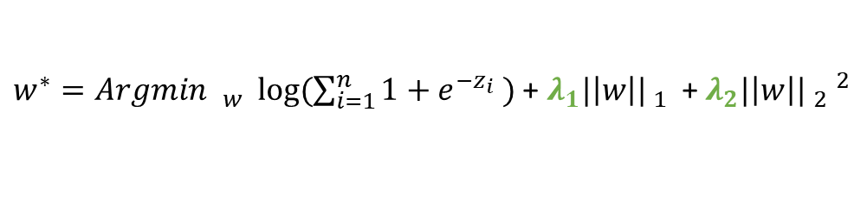


Hyper Parameter Search
Key Points to remember
$λ$ = 0 -> Overfitting
$λ$ = High -> Underfitting
How to determine the value of $λ$?
The value of $λ$ is a real number and the number of possible
values are infinity. So to find the right $λ$ value is Grid Search.
We will plot all the values of $λ$ in X axis and CV error in Y Axis
$λ$ = [0.001, 0.01, 0.1, 1, 10, 100, 1000] and soon
The minimum error we will get is the best value of $λ$
Let’s say we have Elastic Net and here we have two
Hyper Parameters
Problem with Grid Search – More number of times need to
run the algorithm. As the number of Hyper parameter increases
the number of time the model needs to be train increases
exponentially.
Random Search: We can randomly pick the values from the
given interval.
$w^{∗}=Argmin$ $_{w^{ }} log⁡(\sum_{i=1}^{n}{1+e^{−z_{i}} )}+λ|\left|w\right|| _{2} ^{2}$
$w^{∗}=Argmin$ $_{w^{ }} log⁡(\sum_{i=1}^{n}{1+e^{−z_{i}} )}$ + $λ_{1}|\left|w\right|| _{1} ^{ }$+ $λ_{2}|\left|w\right|| _{2} ^{2}$
CV Error
$$λ_{1}$$
$$λ_{2}$$

Slide 44
Column Standardization
Mandatory in Logistic Regression

Slide 45
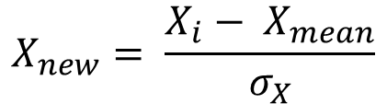
Column Standardization
Key Points to remember
Before training your data we need to perform the
feature standardization
Column standardization is also known as
Mean centering and scaling
$$X_{new}= \frac{X_{i}− X_{mean}}{σ_{X}}$$
$$+ve points$$
$$Vector w$$
$$−ve points$$
$$d_{j}$$
$$x_{i}$$
$$d_{i}$$
$$x_{j}$$
$$π$$

Slide 46
Feature Importance and Model Interpretability
Logistic Regression

Slide 47
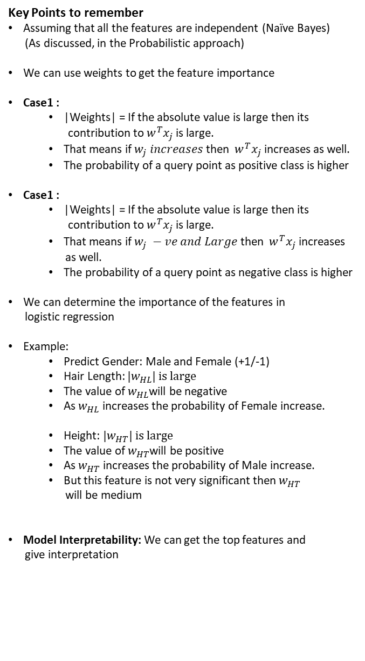
Feature Importance
Key Points to remember
Assuming that all the features are independent (Naïve Bayes)
(As discussed, in the Probabilistic approach)
We can use weights to get the feature importance
Case1 :
|Weights| = If the absolute value is large then its
contribution to $w^{T}x_{j}$ is large.
That means if $w_{j} increases$then $w^{T}x_{j}$ increases as well.
The probability of a query point as positive class is higher
Case1 :
|Weights| = If the absolute value is large then its
contribution to $w^{T}x_{j}$ is large.
That means if $w_{j} −ve and Large$then $w^{T}x_{j}$ increases
as well.
The probability of a query point as negative class is higher
We can determine the importance of the features in
logistic regression
Example:
Predict Gender: Male and Female (+1/-1)
Hair Length: ${|w}_{HL}| is large$
The value of $w_{HL}$will be negative
As $w_{HL}$ increases the probability of Female increase.
Height: ${|w}_{HT}| is large$
The value of $w_{HT}$will be positive
As $w_{HT}$ increases the probability of Male increase.
But this feature is not very significant then $w_{HT}$
will be medium
Model Interpretability: We can get the top features and
give interpretation
$$f → <f_{1}, f_{2}, f_{3}, ………….f_{j}……..f_{d}>$$
$$w → <w_{1}, w_{2}, w_{3}, ………….w_{j}……..w_{d}>$$

Slide 48
Collinearity or Multicollinearity
Logistic Regression

Slide 49
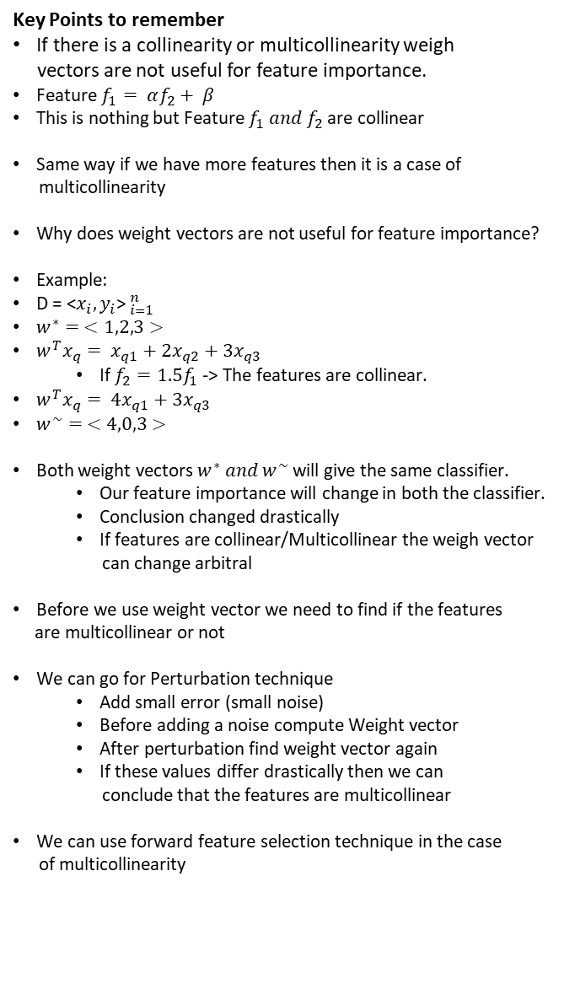
Collinearity or Multicollinearity
Key Points to remember
If there is a collinearity or multicollinearity weigh
vectors are not useful for feature importance.
Feature $f_{1}= αf_{2}+ β$
This is nothing but Feature $f_{1} and f_{2}$ are collinear
Same way if we have more features then it is a case of
multicollinearity
Why does weight vectors are not useful for feature importance?
Example:
D = <$x_{i}, y_{i}$>$_{i=1}^{n}$
$w^{∗}= <1,2,3>$
$w^{T}x_{q}= x_{q1}+2x_{q2}+3x_{q3}$
If $f_{2}=1.5f_{1}$ -> The features are collinear.
$w^{T}x_{q}= {4x}_{q1}+3x_{q3}$
$w^{\sim }= <4,0,3>$
Both weight vectors $w^{∗} and w^{\sim }$will give the same classifier.
Our feature importance will change in both the classifier.
Conclusion changed drastically
If features are collinear/Multicollinear the weigh vector
can change arbitral
Before we use weight vector we need to find if the features
are multicollinear or not
We can go for Perturbation technique
Add small error (small noise)
Before adding a noise compute Weight vector
After perturbation find weight vector again
If these values differ drastically then we can
conclude that the features are multicollinear
We can use forward feature selection technique in the case
of multicollinearity

Slide 50
Train and Run time Space and Time complexity
Logistic Regression

Slide 51
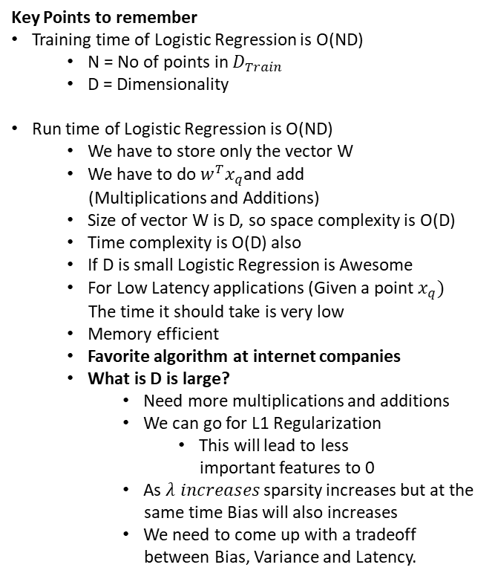
Train and Runtime Space and Time
Key Points to remember
Training time of Logistic Regression is O(ND)
N = No of points in $D_{Train}$
D = Dimensionality
Run time of Logistic Regression is O(ND)
We have to store only the vector W
We have to do $w^{T}x_{q}$and add
(Multiplications and Additions)
Size of vector W is D, so space complexity is O(D)
Time complexity is O(D) also
If D is small Logistic Regression is Awesome
For Low Latency applications (Given a point $x_{q})$
The time it should take is very low
Memory efficient
Favorite algorithm at internet companies
What is D is large?
Need more multiplications and additions
We can go for L1 Regularization
This will lead to less
important features to 0
As $λ increases$sparsity increases but at the
same time Bias will also increases
We need to come up with a tradeoff
between Bias, Variance and Latency.

Slide 52
Real World Cases
Logistic Regression

Slide 53
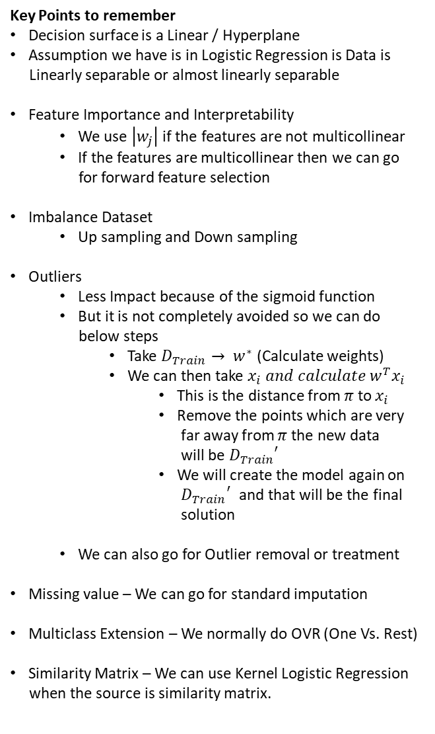
Real World Cases
Key Points to remember
Decision surface is a Linear / Hyperplane
Assumption we have is in Logistic Regression is Data is
Linearly separable or almost linearly separable
Feature Importance and Interpretability
We use $\left|w_{j}\right|$ if the features are not multicollinear
If the features are multicollinear then we can go
for forward feature selection
Imbalance Dataset
Up sampling and Down sampling
Outliers
Less Impact because of the sigmoid function
But it is not completely avoided so we can do
below steps
Take $D_{Train}→ w^{∗}$ (Calculate weights)
We can then take $x_{i} and calculate$ $w^{T}x_{i}$
This is the distance from $π$ to $x_{i}$
Remove the points which are very
far away from $π$ the new data
will be ${D_{Train}}^{′}$
We will create the model again on
${D_{Train}}^{′}$ and that will be the final
solution
We can also go for Outlier removal or treatment
Missing value – We can go for standard imputation
Multiclass Extension – We normally do OVR (One Vs. Rest)
Similarity Matrix – We can use Kernel Logistic Regression
when the source is similarity matrix.

Slide 54
Real World Cases
Key Points to remember
Best and Worst Cases
Almost or Linearly separable
Low Latency Requirements
Very Fast to train
If the data is not Linearly separable the worst
High Dimensionality
If the D is large then the chance of Data to be
linearly separable is high
If we want low latency system we can go for
L1 regularization

Slide 55
Imbalance Data – Geometric View
Logistic Regression

Slide 56
Imbalance Dataset
Key Points to remember
Best and Worst Cases
Almost or Linearly separable
Low Latency Requirements
Very Fast to train
If the data is not Linearly separable the worst
High Dimensionality
If the D is large then the chance of Data to be
linearly separable is high
If we want low latency system we can go for
L1 regularization

